Slide 1

EDUTECH
COVID-19
computer aided learning

Slide 2

Education has remained broadly the same for hundreds of years. Technology is changing that, quickly. So what exactly is education technology or edtech as it is commonly termed?

Slide 3

What Education Technology
Educational technology, also known as EduTech or EdTech, is the combination of computer, it’s tool and educational practices aimed at facilitating learning processes.
Thus educational technology creates, uses, and manages technological processes and educational resources to help improve user academic performance

Slide 4
3 Type of Education Technology Model
Educational technology is the effective use of technological tools in learning. As a Concept, іt concerns an array of tools, such as media, machines and networking hardware, as well as considering underlying theoretical perspectives for their effective application.
Synchronous and Asynchronous
Linear Learning
Collaborative Learning

Slide 5
Synchronous and Asynchronous
Synchronous learning refer to exchange of ideas and information with others participants during the same period. Examples are face-to-face discussion, online real-time live teacher instruction and feedback, Skype conversations, and chat rooms or virtual classroom where everyone is online and working collaboratively at the same time. Since students are working collaboratively, synchronized learning helps students create an open mind because they have to listen and learn from their peers. Synchronized learning fosters online awareness and improves many students writing skills.
.

Slide 6
Synchronous and Asynchronous
Asynchronous learning may use technologies such as email, blogs, wikis, and discussion boards, as well as web-supported textbooks, hypertext documents, audio, video courses, and social networking using web. In asynchronous online courses, students proceed at their own pace. If they need to listen to a lecture a second time, or think about a question for a while, they may do so without fearing that they will hold back the rest of the class. Through online course, students can earn their diplomas more quickly, or repeat failed course without the embarrassment of being in a class with younger students. Students have access to an incredible variety of course, internships, sport or work and still graduate with their class

Slide 7
Linear Learning
Computer-based training(CBT) refers to self-paced learning activities delivered on a computer or handheld device such as a tablet or smartphone. CBT initially delivered content via CD-ROM, and typically presented content linearly, much like reading an online book or manual. For this reason, CBT is often used to teach static processes, such as using software or completing mathematical equations. Computer-based training is conceptually similar to web-based training(WBT) which are delivered via internet using a web browser.
Assessing learning in a CBT is often by assessments that can be easily scored by a computer such as multiple choice questions, drag-and-drop, radio button, simulation or other interactive means. Assessments are easily scored and recorded via online software, providing immediate end-user feedback and completion status. Users are often able to print completion records in the form of certificates.

Slide 8
Collaborative Learning
Computer-supported collaborative learning(CSCL) uses instructional methods designed to encourage or require students to work together on learning tasks. CSCL is similar in concept to the terminology, “e-leaning 2.0” and “networked collaborative leaning”(NCL).
With technological Web 2.0 advances, sharing information between multiple people in a network has become much easier and use has increased. One of the main reasons for its usage state that it is “a breeding group for creative and engaging educational endeavors.
Using Web 2.0 social tools in the classroom allows for students and teachers to work collaboratively, discuss ideas, and promote information. The collaborative tools prepare students with technology skills necessary in today’s workforce.

Slide 9
The Two Education Technology Models
Virtual Class
eLearning
online learning environment that allows for live interaction between the tutor and the learners as they are participating in learning activities
offers the ability to share material in all kinds of formats such as videos, slideshows, word documents, and PDFs.

Slide 10
eLearning System
COVID-19 is an infectious disease caused by the recently found virus known as SARS-CoV-2 (or coronavirus). Before the outbreak originated in Wuhan, China on December 2019, there was no information about this virus

Slide 11
E-learning Systems
E-learning is a rapidly growing industry, the effects of which we can trace back to the 1980s and even well before that (in the form of distance learning and televised courses) – these will be discussed later in this ebook.
Now that affordable e-learning solutions exist for both computers and internet, it only takes a good e-learning tool for education to be facilitated from virtually anywhere. Technology has advanced so much that the geographical gap is bridged with the use of tools that make you feel as if you are inside the classroom
There is a plethora of different e-learning systems (otherwise known as Learning Management Systems, or LMSs for short) and methods, which allow for courses to be delivered. With the right tool, various processes can be automated such as a course with set materials and automatically marked tests.

Slide 12
Learning Management Systems
Learning management systems (LMS) are software platforms for instructors to manage and organize educational courses online and provide students a single location for all course material.
LMSs are used to help streamline information between educational institutions and students over the internet, allowing for increased learning capabilities.
LMSs are composed of a document management component and communication capability, allowing teachers to upload course files such as rubrics, assignments, calendars, and gradebooks, as well as communicate with students via chat rooms or forums. Many LMSs may also offer online assessment functionality, such as quizzes and tests, or offer features that integrate multimedia components such as videos and photos. Students can use LMSs to submit assignments, and many platforms allow instructors to grade assignments within the platform.

Slide 13









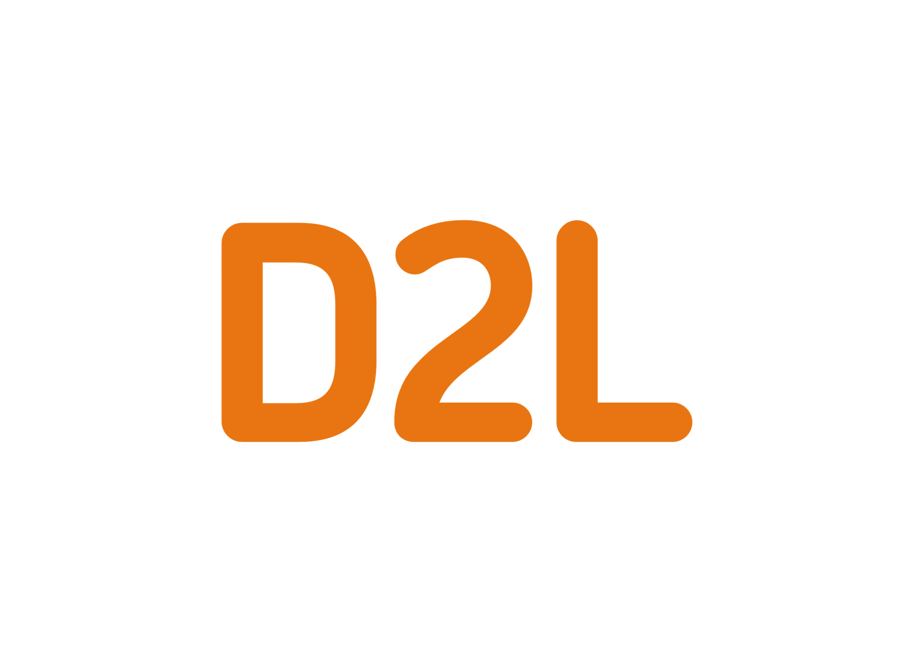


LMS Application
Canvas
Blackboard Learn
Google Classroom
SAP Litmos
Schoology
TalentLMS
Edmodo
Moodle
Absorb LMS
Brightspace
iSpring Learn
LearnUpon LMS

Slide 14
Virtual Classroom
COVID-19 is an infectious disease caused by the recently found virus known as SARS-CoV-2 (or coronavirus). Before the outbreak originated in Wuhan, China on December 2019, there was no information about this virus

Slide 15
Virtual Classroom
In other words, the virtual classroom is a shared online space where the learners and the tutor work together simultaneously. Usually, these interactions take place through videoconferencing. The participants have tools to present learning content in different formats, as well as to implement collaborative and individual activities. In this type of interaction, the teacher has the particularly important role of the moderator who guides the learning process and supports group activities and discussions.
The most common tools you can find in a virtual classroom are:
Videoconferencing
Online whiteboard for real-time collaboration
Instant messaging tool
Participation controls
Breakout rooms

Slide 16






Virtual Classroom Application
Newrow Smart
Vedamo
BigBlueButton
Electa Live
Adobe Connect
WizIQ

Slide 17
Sources and Reference
EdTech:
https://wibbu.com/what-is-edtech-and-why-is-it-the-future/
https://en.wikipedia.org/wiki/Educational_technology
https://www.e-spincorp.com/3-difference-types-of-educational-technology/
Virtual Classroom:
https://www.vedamo.com/knowledge/what-is-virtual-classroom/
Elearning:
https://www.talentlms.com/elearning/what-is-elearning
LMS:
https://elearningindustry.com/the-20-best-learning-management-systems

